Slide 1
C++ Game Engine
James Price (19108410)

Slide 2
Project outcomes
To develop a 3D game engine using C++ with SDL2 and OpenGL
To create a main game scene that meets a set of assessment criteria and personal criteria
The game level will consist of a small village with basic buildings int it, with some large open spaces and wide roads, allowing players to run around shooting as well as getting into a tank and driving it around in 3rd person

Slide 3
Plan Overview
Stage One Requirements | Done | Stage Two Requirements | Done
FPS Camera | Yes | Height map terrain | Yes
Loading objects from file | Yes | Dynamic models | Yes
5+ static objects | Yes
Simple terrain | Yes
Moveable player | Yes
Textures | Yes
Skybox | Yes
Table 1: The list of different requirements for the assessment brief with Stage One being the 40% boundary and each Stage after that being the subsequent marking boundary

Slide 4
Plan Overview (Cont.)
Stage Three Requirements | Done | Stage Four Requirements | Done
Load from file without Assimp | Yes | Bump mapping | No
Heads Up Display / GUI | Yes | Lighting and shadows | No
 |  | Reflections | No
 |  | Particle systems | No
Table 2: A continuation of Table 1 with the final two stages for the marking criteria
Ideally the requirements chosen from the assessment criterial will be completed as soon as possible and then extra features from the criteria can be implemented

Slide 5
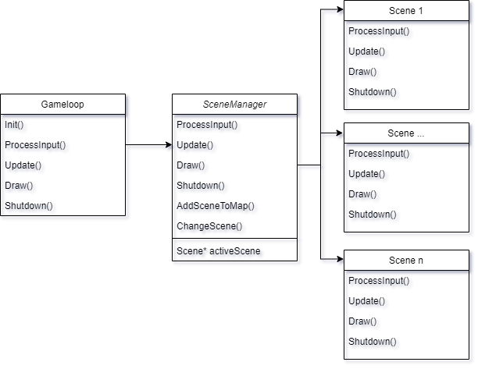
Scene manager
Figure 1: A basic diagram of how the Gameloop, SceneManager and Scenes are structured in the project

Slide 6
Skybox vs Skydome
Reasons for Skybox | Reasons for skydome
Easier to implement | Less chance of seams
Requires less vertices | Less chance of warped perspective (compared to skybox)
Faster to draw | More flexible for various resolutions
 | Can use HDRI image that can encode more data about how the image is lit
Table 3: List of reasons for either skybox or skydomes
The idea for the project is to try to implement a skydome and test it on a low end system once the other features are implemented and if frame rates are within acceptable parameters it can be used as the permanent solution, if not then a skybox will be used, as a personal aspiration of the project is to get the engine running on low end systems with high performance

Slide 7
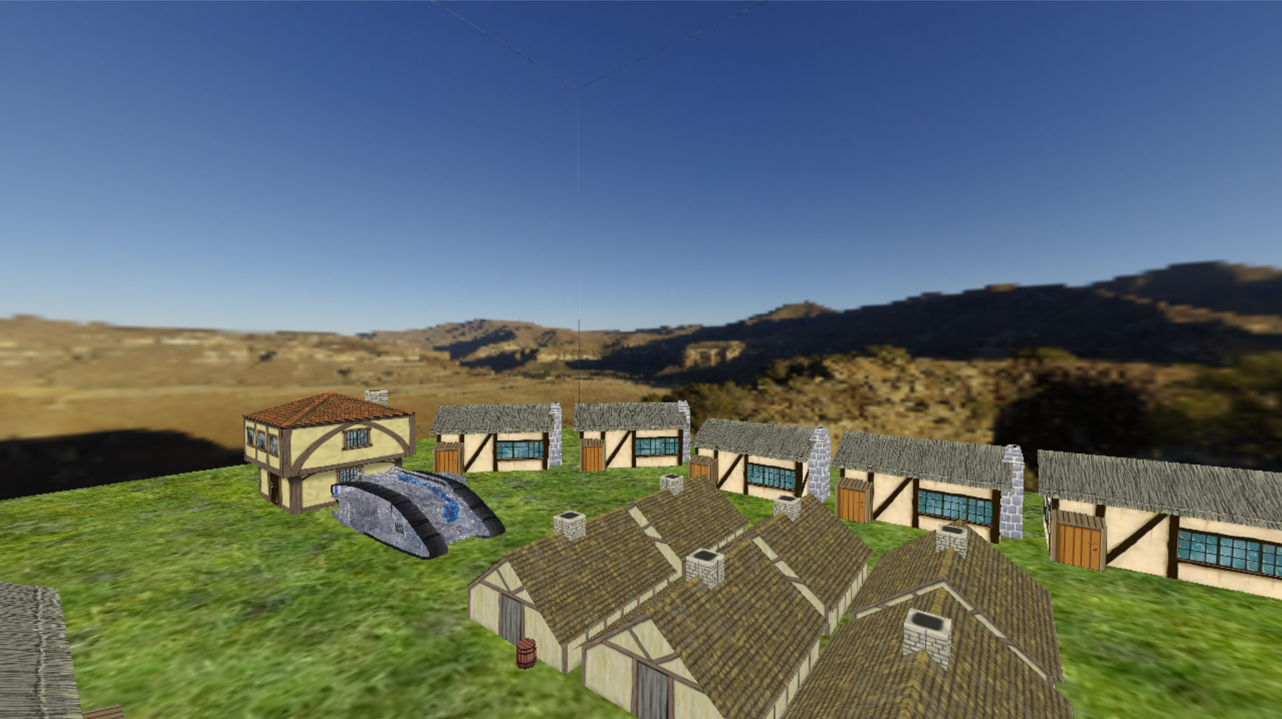
Current view of the game
Figure 2: A screenshot of the game scene

Slide 8
Initial performance statistics
Scene description | Number of draw calls | Average estimated FPS
A spinning monkey with no texture (uses vertex colours) | 1 | 3381 FPS
A basic scene with textured houses, ground plane, tanks and a skybox | 7 | 2051 FPS
Table 2: A table of performance metrics with varying scene complexity and computational steps

Slide 9
Issues/Areas to be improved
Currently For each model being rendered to screen there either needs to be a separate model Renderer or the models need to be merged together in software like blender and then exported as a unique wavefront file
Problems: Using multiple renderers uses more draw calls and more CPU overhead. Merging objects externally creates lots of files with dupilacte data; thus, wasting memory/storage space
Proposed solution: Develop a form of the model renderer than can use instancing or merging to reduce draw calls and decrease storage usage
The mouse does not get locked to the window
Problems: Looking around is clunky and not fit for purpose
Proposed solution: use SDL to keep the mouse in the centre of the window and slightly tweak how the mouse is tracked

Slide 10
References
Turbosquid.com. n.d. prototyping 2012 3d. [online] Available at: <https://www.turbosquid.com/3d-models/prototyping-2012-3d/702544> [Accessed 20 February 2021].
Turbosquid.com. n.d. free 3ds model mark v tank. [online] Available at: <https://www.turbosquid.com/3d-models/free-3ds-model-mark-v-tank/525014> [Accessed 2 March 2021].
Zaal, G., n.d. HDRI: Kiara 7 Late-Afternoon | HDRI Haven. [online] HDRI Haven. Available at: <https://hdrihaven.com/hdri/?c=skies&h=kiara_7_late-afternoon> [Accessed 2 March 2021].

Slide 11
Demo / Questions

